Slide 1



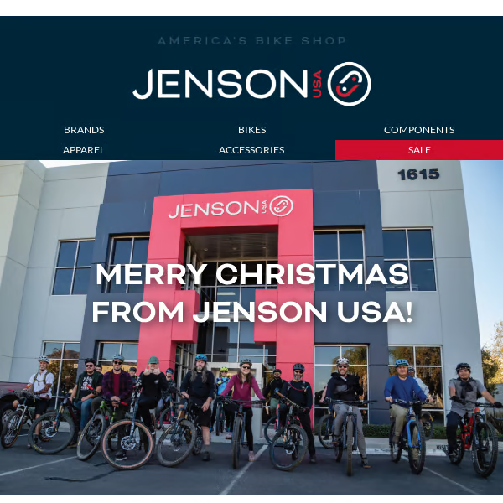


Weekly Project - 6 SQL
JENSON
Presented By:
Anoop Alabnoor
www.linkedin.com/in/anoop1420

Slide 2
ABOUT JENSON USA
Jenson USA is a leading retailer in the cycling industry, specializing in high-quality bikes, components, accessories, and apparel. Founded in 1994, the company has built a strong reputation for its excellent customer service, competitive pricing, and a wide range of products catering to cyclists of all skill levels. Jenson USA offers an easy-to-navigate online shopping experience, backed by expert advice and a satisfaction guarantee. With a passion for cycling and a commitment to innovation, Jenson USA continues to inspire and support the cycling community worldwide.

Slide 3
QUESTIONS
1.FIND THE TOTAL NUMBER OF PRODUCTS SOLD BY EACH STORE ALONG WITH THE STORE NAME.
2.CALCULATE THE CUMULATIVE SUM OF QUANTITIES SOLD FOR EACH PRODUCT OVER TIME.
3.FIND THE PRODUCT WITH THE HIGHEST TOTAL SALES (QUANTITY * PRICE) FOR EACH CATEGORY.
4.FIND THE CUSTOMER WHO SPENT THE MOST MONEY ON ORDERS.
5.FIND THE HIGHEST-PRICED PRODUCT FOR EACH CATEGORY NAME.
6.FIND THE TOTAL NUMBER OF ORDERS PLACED BY EACH CUSTOMER PER STORE.
7.FIND THE NAMES OF STAFF MEMBERS WHO HAVE NOT MADE ANY SALES.
8.FIND THE TOP 3 MOST SOLD PRODUCTS IN TERMS OF QUANTITY.
9.FIND THE MEDIAN VALUE OF THE PRICE LIST.
10.LIST ALL PRODUCTS THAT HAVE NEVER BEEN ORDERED.(USE EXISTS)
11.LIST THE NAMES OF STAFF MEMBERS WHO HAVE MADE MORE SALES THAN THE AVERAGE NUMBER OF SALES BY ALL STAFF MEMBERS.
12.IDENTIFY THE CUSTOMERS WHO HAVE ORDERED ALL TYPES OF PRODUCTS (I.E., FROM EVERY CATEGORY).

Slide 4
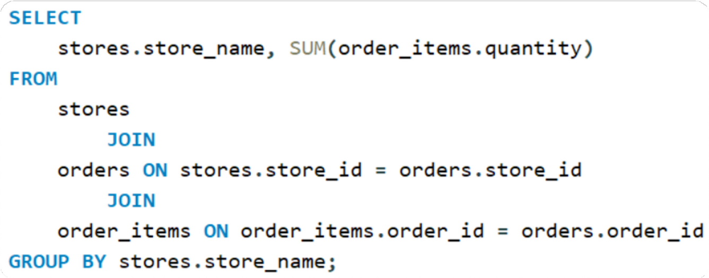
1.FIND THE TOTAL NUMBER OF PRODUCTS SOLD BY EACH STORE ALONG WITH THE STORE NAME.

Slide 5
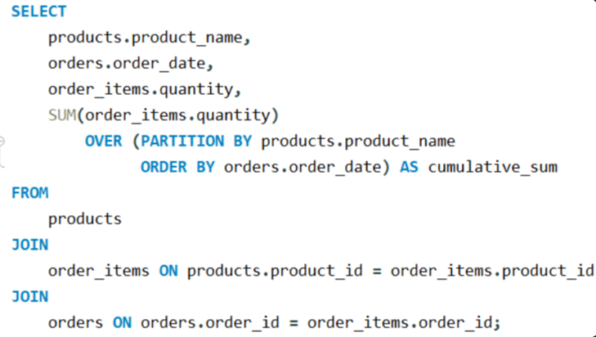
2.CALCULATE THE CUMULATIVE SUM OF QUANTITIES SOLD FOR EACH PRODUCT OVER TIME.

Slide 6
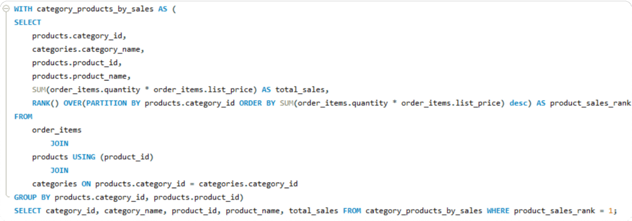
3.FIND THE PRODUCT WITH THE HIGHEST TOTAL SALES (QUANTITY * PRICE) FOR EACH CATEGORY.

Slide 7
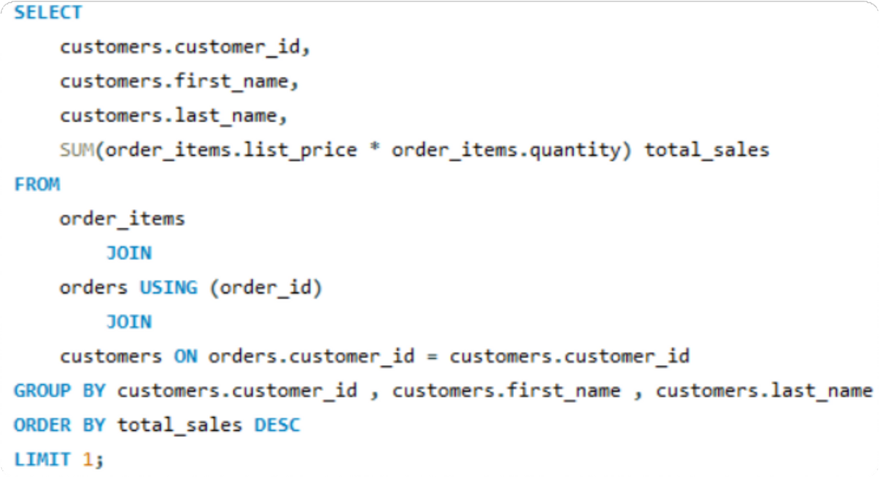
4.FIND THE CUSTOMER WHO SPENT THE MOST MONEY ON ORDERS.

Slide 8
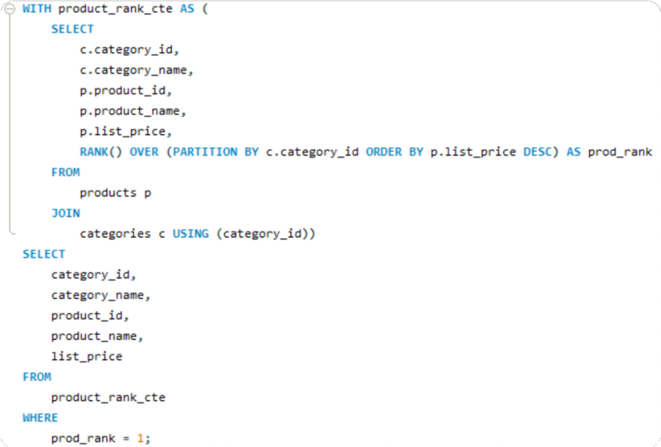
5.FIND THE HIGHEST-PRICED PRODUCT FOR EACH CATEGORY NAME.

Slide 9
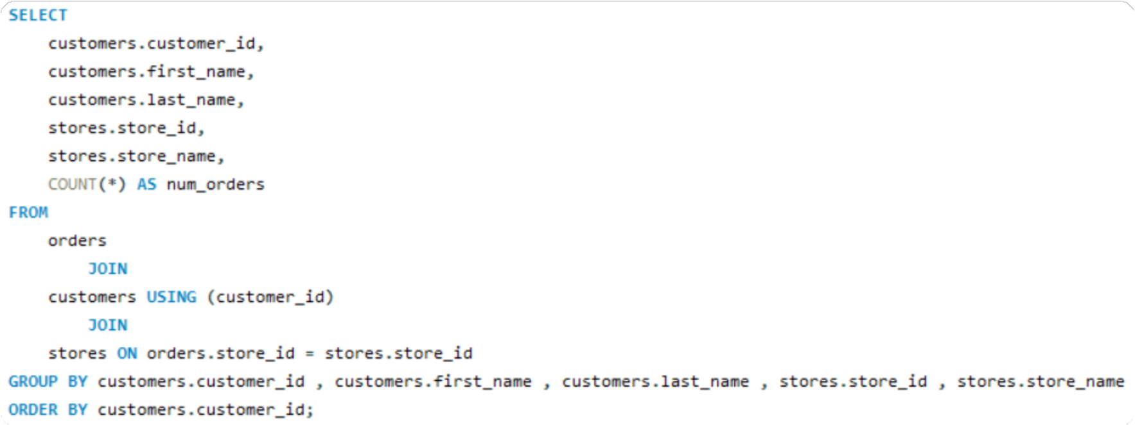
6.FIND THE TOTAL NUMBER OF ORDERS PLACED BY EACH CUSTOMER PER STORE.

Slide 10
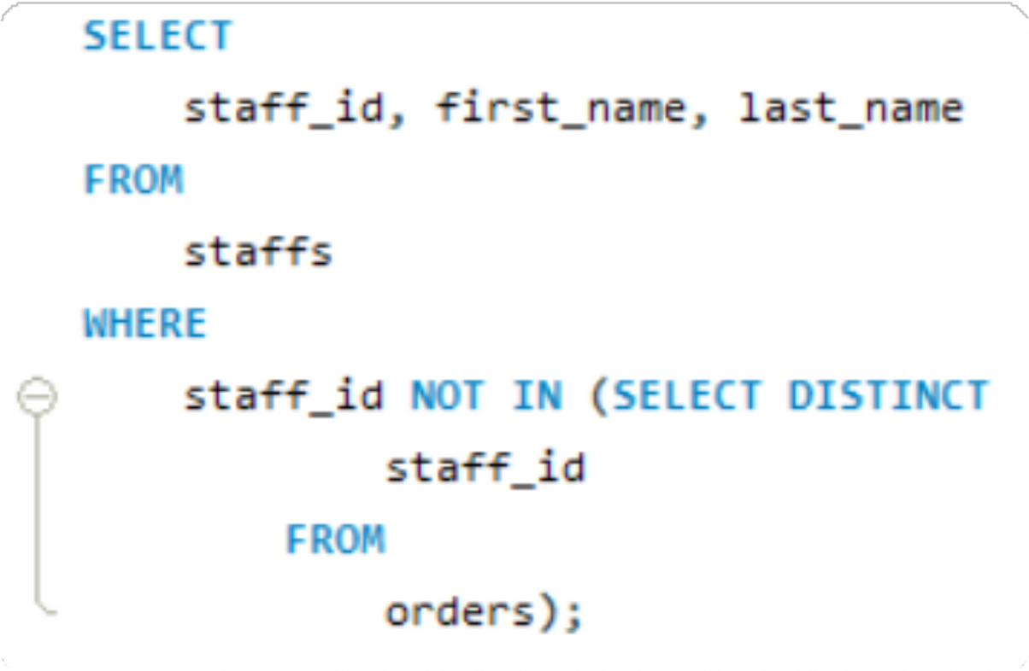
7.FIND THE NAMES OF STAFF MEMBERS WHO HAVE NOT MADE ANY SALES.

Slide 11
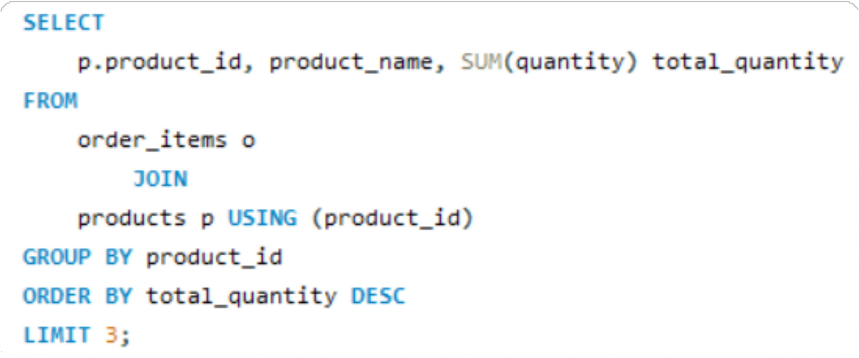
8.FIND THE TOP 3 MOST SOLD PRODUCTS IN TERMS OF QUANTITY.

Slide 12
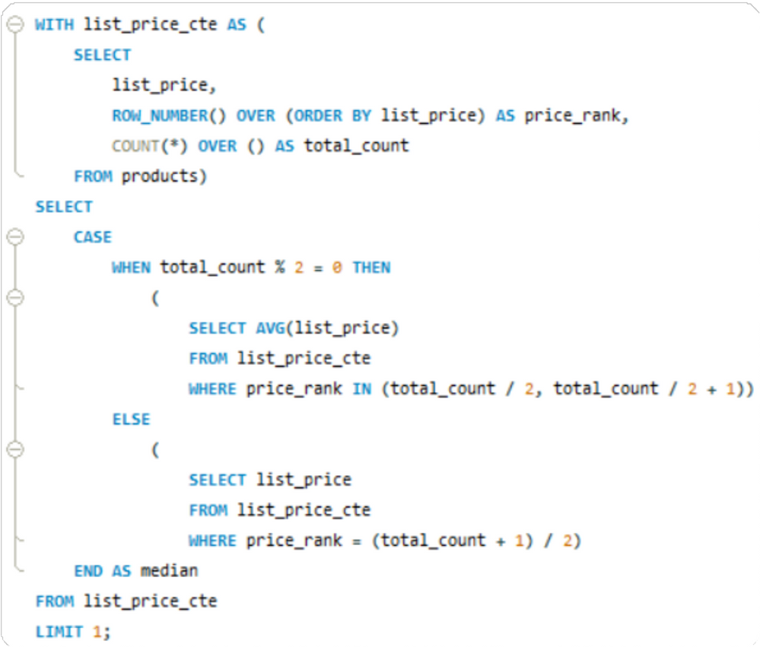
9.FIND THE MEDIAN VALUE OF THE PRICE LIST.

Slide 13
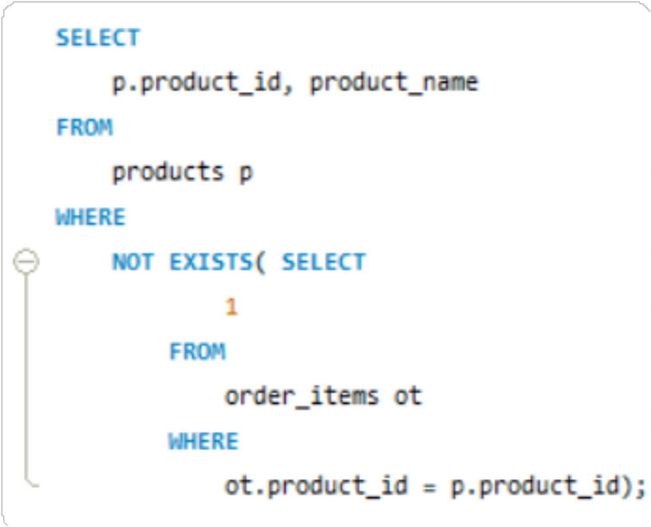
10.LIST ALL PRODUCTS THAT HAVE NEVER BEEN ORDERED.(USE EXISTS)

Slide 14
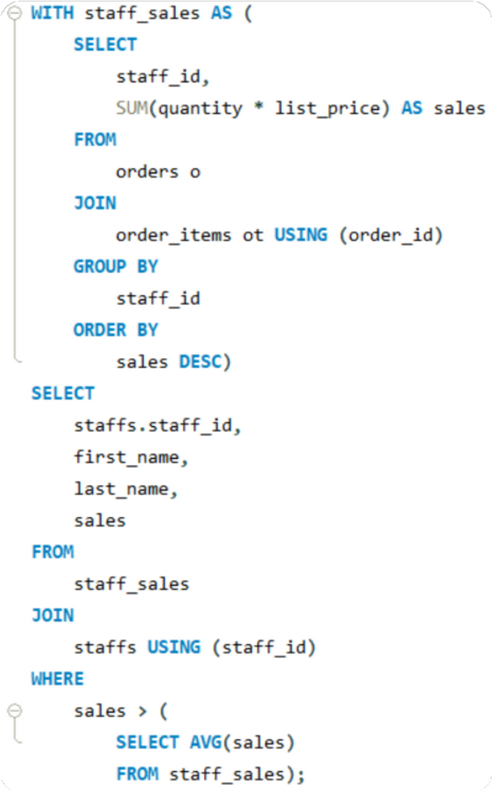
11.LIST THE NAMES OF STAFF MEMBERS WHO HAVE MADE MORE SALES THAN THE AVERAGE NUMBER OF SALES BY ALL STAFF MEMBERS.

Slide 15
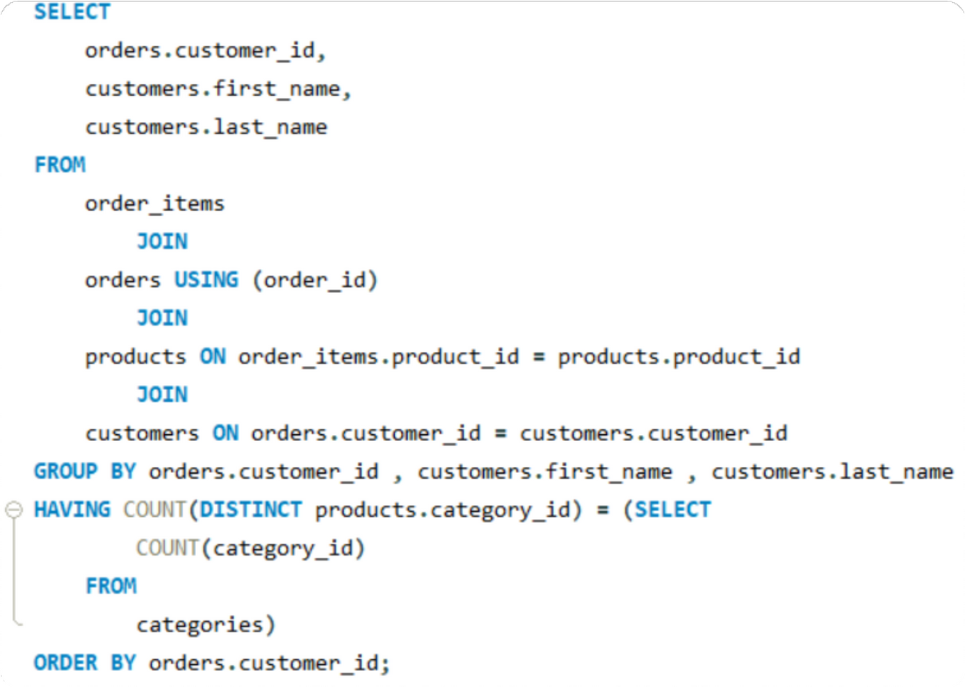
12.IDENTIFY THE CUSTOMERS WHO HAVE ORDERED ALL TYPES OF PRODUCTS (I.E., FROM EVERY CATEGORY).

Slide 16

THANK YOU
www.linkedin.com/in/anoop1420

